Slide 1


Innovate. Empower. Secure.
AUTOPEN

Slide 2

AUTOPEN
Inno2vate. Secure. Optimize.

Slide 3
AUTOPEN
Innovate. Secure. Optimize.

Slide 4


Team Introduction
Joshua
Buscher
Documentation Specialist​
Calla Robison
Web Developer - Backend and Web Design ​
Michael Allen
Project Planner and Pentester​
Caleb Hall
Scrum Master and Pentester​
Myles Scott
Web Developer – Frontend and Web Design

Slide 5

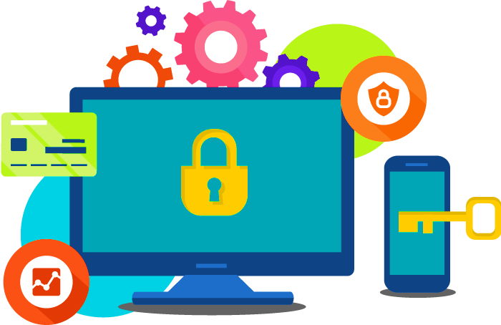



Mission
A Safer Digital World through more accessible security
Empowering Organization Cybersecurity
through driving down testing costs
Distribute an online method for companies to easily test their own website vulnerabilities
This Photo by Unknown Author is licensed under CC BY-NC

Slide 6

Timeline
Sprint 1
Sprint 2
Sprint 3
Scope Changes:
Environmental changes/ scope redesign
UI/UX Web:
Website creation and Droplet set Up
Product Finalization:
Page refinement and full back-end integration

Slide 7
What's Next?
User information
Data Visualization
Streamlined Communication

Slide 8


Moving Foward
Backend
Significant front end progress this sprint
Moving on to back end
Python scripts for API calls
More secure
Database implementation
Allow for user accounts
Full login functionality

Slide 9
Moving Foward
Frontend
User Dashboard
Data visualization
Filtering options for data visuals

Slide 10
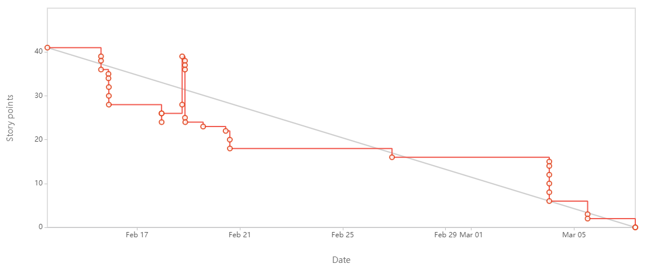
Burndown

Slide 11
Design Considerations
Constraints
Safety
Assumptions
Skill
Funding
Physical
Cyber
Legality
Users

Slide 12



Budget
Breakdown
Digital Ocean Services
$28/mo. for Droplet
Student license gets $200 credit
Burp Suite API
$300/yr
Covered
Sitegrounds
$25/yr to host
$8 domain name

Slide 13
Migration²
Localhost -> Sitegrounds
Sitegrounds cloud web hosting service
Many built in tools
Easy to use
Completed
Sitegrounds -> DigitalOceans
Cloud VM
Download any needed tools
Customizable
NGNIX web server
In progress

Slide 14
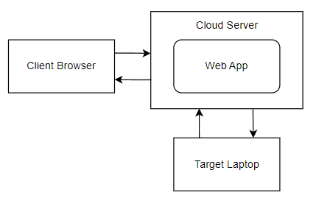
System Architecture

Slide 15
Hardware
Three pieces
Client
Various
Any browser
Cloud server
2 core CPU
4GB RAM
80GB NVMe SSD
Target laptop
VMWare Kali VM
6 core CPU
16GB RAM
80GB NVMe SSD

Slide 16
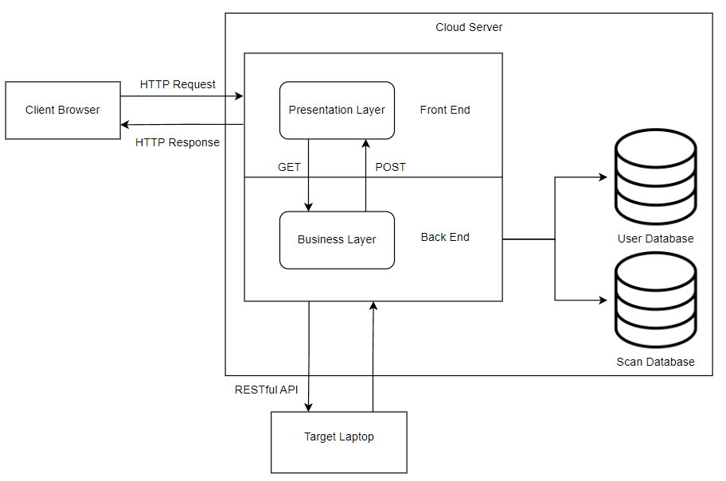
Sub-System Design: Web App

Slide 17
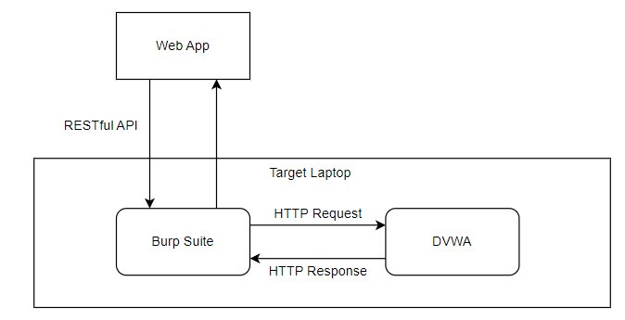
Sub-System Design: Target

Slide 18

DEMO

Slide 19



Lessons Learned
This Photo by Unknown Author is licensed under CC BY-NC
Communication
Planning
Workflow
Mission Statement: Empowering Organization Cybersecurity through the democratization of vulnerability testing​
Vision: A Safer Digital World through more accessible Security​
Core Values: Accessibility, Reliability, User-Centric Design​
​
End Goal: Distribute an online method for companies to easily test their own website vulnerabilities

Slide 20

Q&A

Slide 21


Security Solutions
This Photo by Unknown Author is licensed under CC BY-NC
Cost Efficient
Mission Statement: Empowering Organization Cybersecurity through the democratization of vulnerability testing​
Vision: A Safer Digital World through more accessible Security​
Core Values: Accessibility, Reliability, User-Centric Design​
​
End Goal: Distribute an online method for companies to easily test their own website vulnerabilities

